Slide 1
Personality Prediction Using Resume
Extracting insights from resumes can provide valuable information about a candidate's personality and soft skills. By applying machine learning techniques, we can uncover patterns in resume data that can predict an individual's personality traits.
Project by -
Vrishti Sharma, Tanya Gupta, Sahil Yadav, Arpit Pandey

Slide 2
Why Personality Matters in Hiring
Cultural Fit
Personality traits can indicate how well a candidate will integrate into the company culture and work collaboratively with the team.

Slide 3
Soft Skills
Personality attributes like communication, problem-solving, and leadership can be just as important as technical skills for many roles.

Slide 4
What Can We Learn From Resumes?
Career History
Analyzing a candidate's work experience and job transitions can reveal their adaptability and willingness to take on new challenges.
Accomplishments
The way candidates describe their achievements can provide insights into their problem-solving skills and drive for success.
Hobbies and Interests
A candidate's extracurricular activities can indicate their passions, creativity, and work-life balance preferences.

Slide 5
Extracting Personality Traits from Resumes
Text Analysis
Applying natural language processing to identify the language patterns and word choices in resumes.
Skills and Achievements
Evaluating the types of skills listed and how accomplishments are framed to infer personality attributes.
Behavioral Cues
Detecting subtle behavioral cues, such as the use of active or passive voice, to uncover personality traits.

Slide 6



Validating the Predictions
Personality Surveys
Comparing the model's predictions to the candidate's self-reported personality assessment results.
Peer Feedback
Gathering feedback from colleagues and managers to validate the predicted personality traits in real-world settings.
Performance Metrics
Analyzing how the predicted personality traits align with the candidate's job performance and career progression over time.

Slide 7
Practical Applications and Use Cases
Talent Acquisition
Identifying candidates whose personality profiles match the desired traits for a specific role or team.
Employee Development
Designing personalized training and mentorship programs to address individual growth opportunities.
Team Building
Assembling well-rounded teams with complementary personality traits to foster collaboration and productivity.

Slide 8
Ethical Considerations and Future Outlook
Bias Mitigation | Ensuring the prediction models are not perpetuating harmful biases and that the personality assessment process is fair and inclusive.
Privacy Concerns | Addressing data privacy and consent issues, as resume data can contain sensitive personal information.
Continuous Improvement | Ongoing refinement of the prediction models and validation techniques to enhance the accuracy and reliability of the personality assessments.

Slide 9
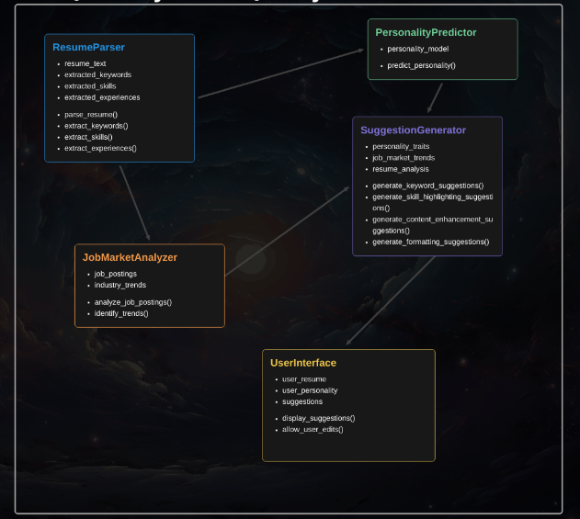
Class Diagram

Slide 10
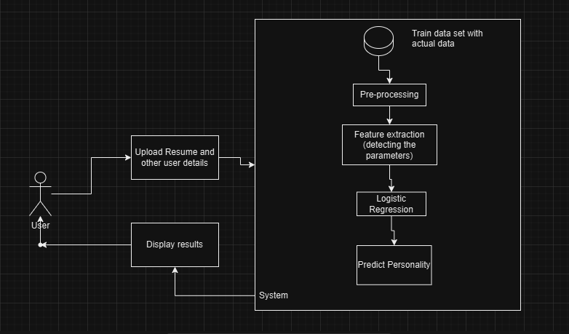
UML Diagram

Slide 11
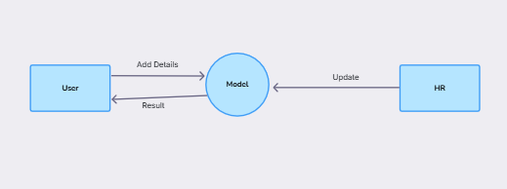
Data Flow Diagram (0 Level)

Slide 12
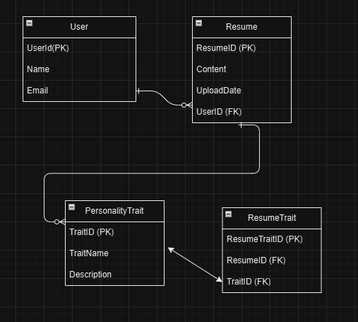
ER- Diagram

Slide 13
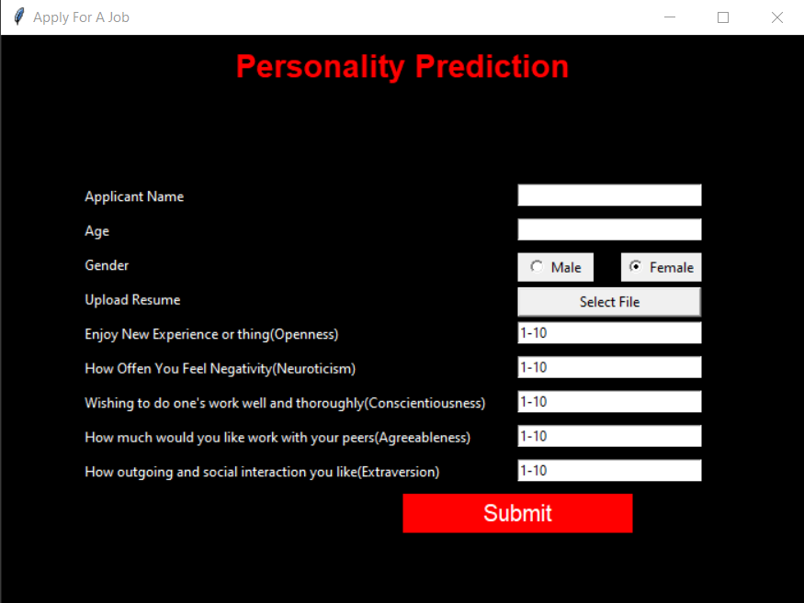

Slide 14
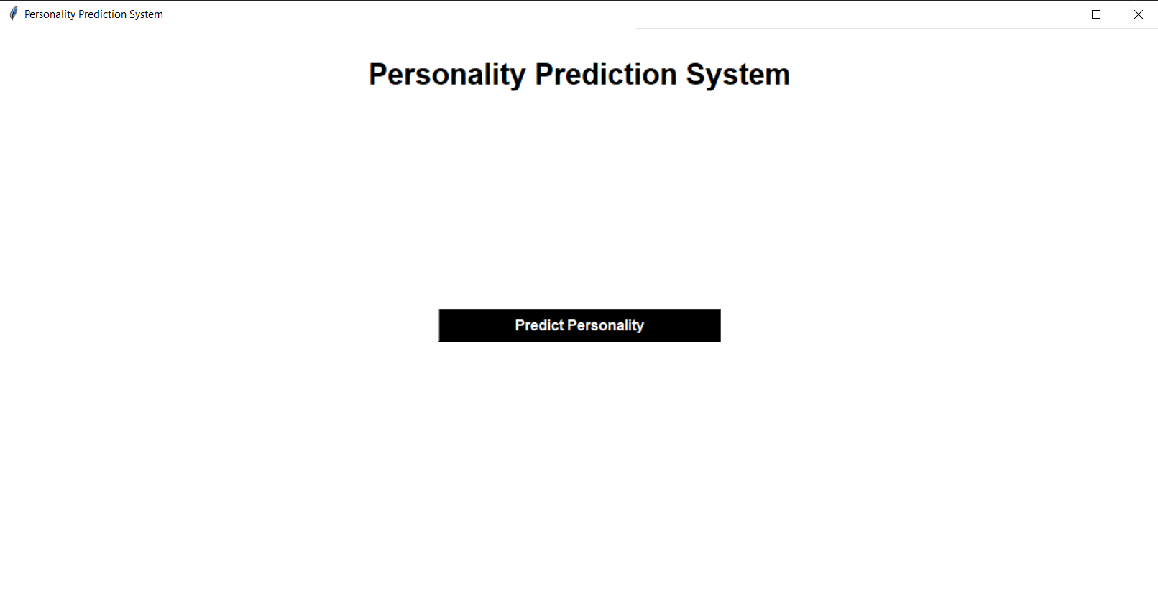

Slide 15
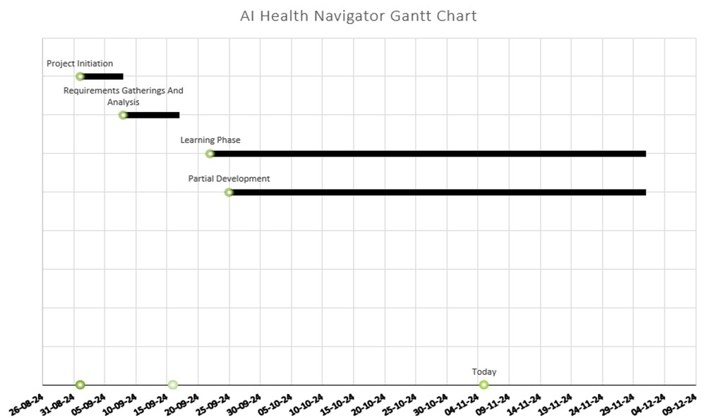

Slide 16
THANK YOU

